Slide 1

86 FORCE SUPPORT SQUADRON
CASH HANDLING TRAINING

Slide 2
Background
The goal of this training is to establish and reinforce 86 FSS basic guidelines for
controlling and safeguarding non-appropriated funds (NAF) cash and other
assets in accordance with Operating Instruction (OI) 34-217 and AFMAN 34
-202; Chapter 4, Controlling Cash and Cash Equivalents.

Slide 3
Introduction
In this training, you will see that there is no smoke and mirrors; no brain-busting
equations that only managers and supervisors of your facilities can crack - only a
few fundamental rules for handling and protecting your funds.
In the following slides, we will discuss:
Cashier Responsibilities
Mangers Surprise Cash Count Responsibilities
Resource Protection

Slide 4

CASH HANDLING TRAINING
Whenever you are handling cash, paying attention to detail is key! Keep cash register drawers orderly at all times.
Arrange currency with like denominations.
Remove excess cash or large bills.
Document excess cash on AF Form 2557 to record transfer.
Count change twice: when taken from drawer and given to customer.

Slide 5
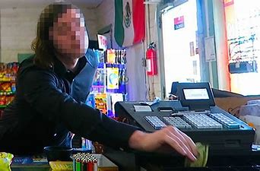
CASH HANDLING TRAINING
Do not leave funds unattended or with unauthorized persons at any time.

Slide 6
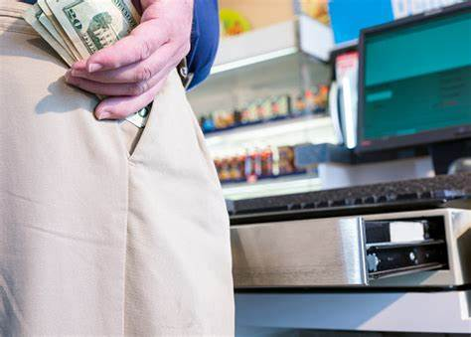
CASH HANDLING TRAINING
Do not store personal funds or property in your drawer or register area.
Unauthorized persons are not allowed in areas where funds are stored.
Check cash drawer to ensure there are no bills, receipts, or documentation left under drawer at the end of each shift.

Slide 7
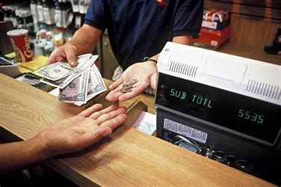
CASH HANDLING TRAINING
Helpful Tip: When giving change to your customer,
Do not put the customer’s money in your cashier drawer; rather, place customers money on the register top until the transaction is completed. First, count the return change out of your cashier drawer, then count to yourself, and finally to your customer. Following this procedure gives the cashier the opportunity to validate correctness of counting the return change to the customer three different times!

Slide 8
CASH HANDLING TRAINING
Your primary responsibility as a cashier is to transact business; to receive payment for services and merchandise or food. When you sign out funds for your shift, you must be aware that you and you alone are responsible for those funds. Listed below are helpful hints to help you ensure an "even" drawer. As your shift begins, you will receive, count, and sign for your funds in the "Received By" section of Section I of the Cashier's Report (CR) on AF Form 1875. At the end of your shift, count your funds in a secure location, enter the total amount of cash in Section II of the CR, turn in funds and CR to Head Cashier, Witness the Head Cashier fill out Section VI of the CR and keep the receipt.
Remember:

Slide 9
CASH HANDLING TRAINING
Check Cashing Policy
Procedures when accepting a check from a customer:
Checks may only be taken for exact amount of purchase, except as listed below.
Personal checks for purchase or payments up to $3,000.00.
Larger checks must be approved by RMFC or designee.
Where checks are accepted, SSC check cashing notice must be posted.
Managers and cashiers may not cash own checks
Cashiers will: Review the most current dishonored check listing. *NOTE* Keep this listing out of the customer's view. It contains privacy act information and must be safeguarded.

Slide 10
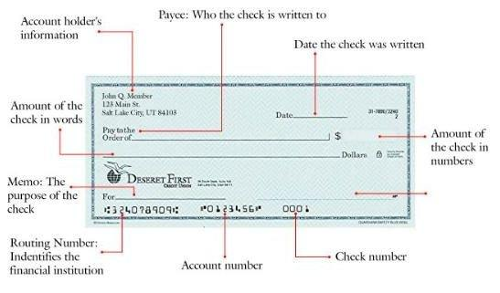
CASH HANDLING TRAINING
Check Cashing Policy continued…
When accepting a check from a customer, you must:
Ensure that each check has the sponsor's name, rank, organization, DOD ID number home address, and local duty phone number.
Ensure agreement between printed and written dollar amounts.
Ensure customer’s identity is same on check as on individual’s ID card.
Ensure that “Pay to the Order of” information is completed.

Slide 11
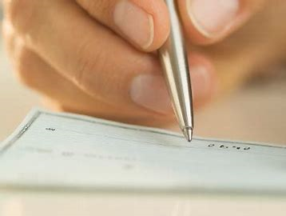
CASH HANDLING TRAINING
Check Cashing Policy continued…
When accepting a check from a customer, you must:
Cashier must initial the upper left hand corner of the check.
Dishonored Checks: Procedures for dishonored checks are contained in AFMAN 34-202, para 4:18 through 4.20.
You are the only barrier against repeated dishonored checks; so, you must check the dishonored check list every time a check is presented.

Slide 12

CASH HANDLING TRAINING
Questions?

Slide 13
Surprise Cash Counts Training Objective
Trainees will be able to:
Correctly identify the purpose for surprise cash counts
Identify correct procedures for performing surprise cash counts
Correctly determine if appropriate internal controls are implemented and effective

Slide 14
AFMAN 34-202 Surprise Cash Count Instructions Training
4.10. All FSS activities and functions are subject to surprise cash counts.
4.10.1. The activity manager, or designated representative, who has no involvement with the cash function, makes a surprise cash count of all change funds, imprest funds, and receipts on hand in the activity at least quarterly. In small activities where the activity manager usually performs cashier duties, the flight chief appoints an individual to conduct the surprise cash count. The cash count of the funds controlled by a general change fund cashier includes all "banks" which have not been issued to other cashiers. AFMAN34-202, Chapter 4.

Slide 15

AFMAN 34-202 Instructions Training continued…
Reviews expenditures and advances from petty cash to
ensure they were approved and are supported by AF Form 2557, or AF Form
1401, Air Force Petty Cash/Refund Voucher.
2. Ensure, when added to the cash on hand, the balance equals the amount of funds signed for.

Slide 16
AFMAN 34-202 Surprise Cash Count Instructions Training
Performing Surprise Cash Counts, Use AF Form 2556
  Count like items / denominations of cash together
  Enter each item individually on the AF Form 2556 ($1, $5, nickels, dimes, checks, etc.)
  Review expenditures and advances from petty cash to ensure that they have been approved and are supported by an AF Form 2557 or 1401
    When the receipts are added to the cash on hand, the balance should equal the amount of funds signed for and recorded in the General Ledger in GLAC 105xx
  Ensure the amount of funds counted agrees with the amount receipted for on the cash receipt voucher
  Sign the AF Form 2556 as the verifier

Slide 17
AFMAN 34-202 Surprise Cash Count Instructions Training
Use AF Form 2556
    Obtain the signature of the responsible individual on the cash count form acknowledging the return of all cash and cash items
    Ensure funds are stored in the safe when not in use
    The AF Form 2556 is retained in the activity and a copy provided to RM for review
    The NAFFA is responsible for reviewing documentation on file to assure that these surprise cash counts have been performed as required

Slide 18
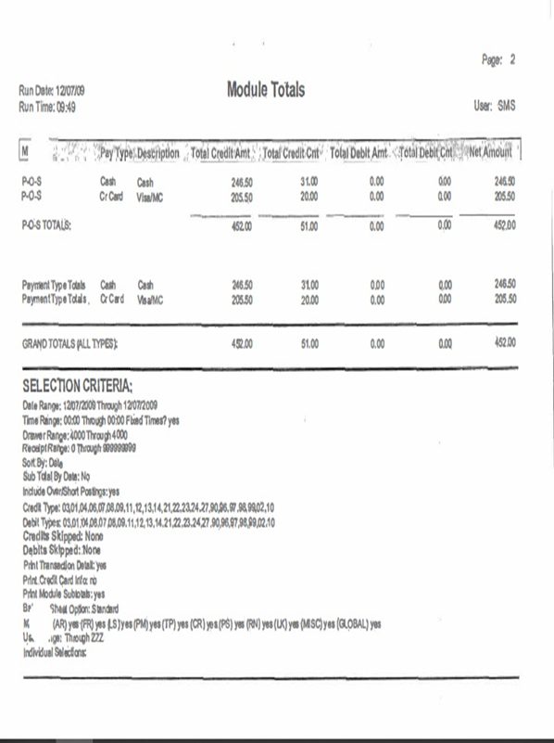
AFMAN 34-202 Instructions Training, continued…
NAF SURPRISE OR GENERAL CASHIER'S CASH COUNT
NAFI/COST CENTER 441XX/0000 | Your Facility |  |  | DATE |  | TIME .
DENOMINATION |  | U.S. OR FOREIGN |  | ACCOUNTABLE FORMS REVIEWED
U.S | FOREIGN | QUANTITY | AMOUNT | TYPE FORM | BEGIN NUMBER | END NUMBER
WRAPPED | WRAPPED
$100 | € 100 | 0 | $0.00
$50 | € 50 | 0 | $0.00
$20 | € 20 | 0 | $0.00
$10 | € 10 | 0 | $0.00
$5 | € 5 | 0 | $0.00
$2 | € 2 | 0 | $0.00
$1 | € 1 | 25 | $25.00 | REMARKS | Disbursements:
 | Rolled | 0
 | € 2 | 0 | $0.00
 | € 1 | 0 | $0.00
 | .50 | 0 | $0.00 | DOLLAR CHANGE FUND
Rolled | .20 | 0 | $0.00 | EURO CHANGE FUND
.25 | .10 | 0 | $0.00 | 2557's: $300.00 funds Signed For
.10 | .05 | 0 | $0.00
.05 | .02 | 0 | $0.00
.01 | .01 | 0 | $0.00 | ACCOUNTABILITY
LOOSE $100 | LOOSE |  |  | OPEN REGISTER READING |  | $752.10
$50 | € 2 | 0 | $0.00 | CLOSE REGISTER READING |  | $452.00
$20 | € 1 | 13 | $260.00 | TOTAL REGISTER SALES |  | $452.00
$10 | .50 | 1 | $10.00 | TOTAL NONREGISTER CASH RECEIPTS |  | $0.00
$5 | .20 | 27 | $135.00 | TOTAL |  | $0.00
$1 | .10 | 103 | $103.00 | LESS CHARGE SALES (2557) |  | $205.50
.25 | .05 | 40 | $10.00 | CASH SALES TOTAL |  | $246.60
.10 | .02 | 26 | $2.60 | UNDER/OVER RINGS
.05 | .01 | 20 | $1.00 | TOTAL |  | $0.00
.01 | .10 | 0 | $0.00
CREDIT CARDS |  |  | $205.50 | CASH AND CHARGE TOTAL |  | $452.10
1401s |  |  | $0.00
2557 |  |  | $0.00 | ADD CHANGE FUND |  | $300.00
TOTAL CASH |  |  | $752.10 | TOTAL ACCOUNTABILITY |  | $752.10
 |  |  |  | OVER/SHORT |  | $0.10
I CERTIFY THE RECONCILIATION DATA AND THE TOTAL AMOUNT OF CASH, NEGOTIABLE INSTRUMENTS, AND CHARGE TICKETS WERE COUNTED BY ME; AND THE AMOUNT SHOWN IS CORRECT. |  |  |  | I CERTIFY ALL CASH, NEGOTIABLE INSTRUMENTS, AND CHARGE TICKETS FOR WHICH I AM RESPONSIBLE, AS LISTED ON THIS FORM, WERE RETURNED TO ME.
SIGNATURE AND PRINTED NAME OF VERIFIER |  |  |  | SIGNATURE AND PRINTED NAME OF CASHIER (Fund Holder)
AF 2556, V2 |  | PREVIOUS EDITION MAY BE USED

Slide 19
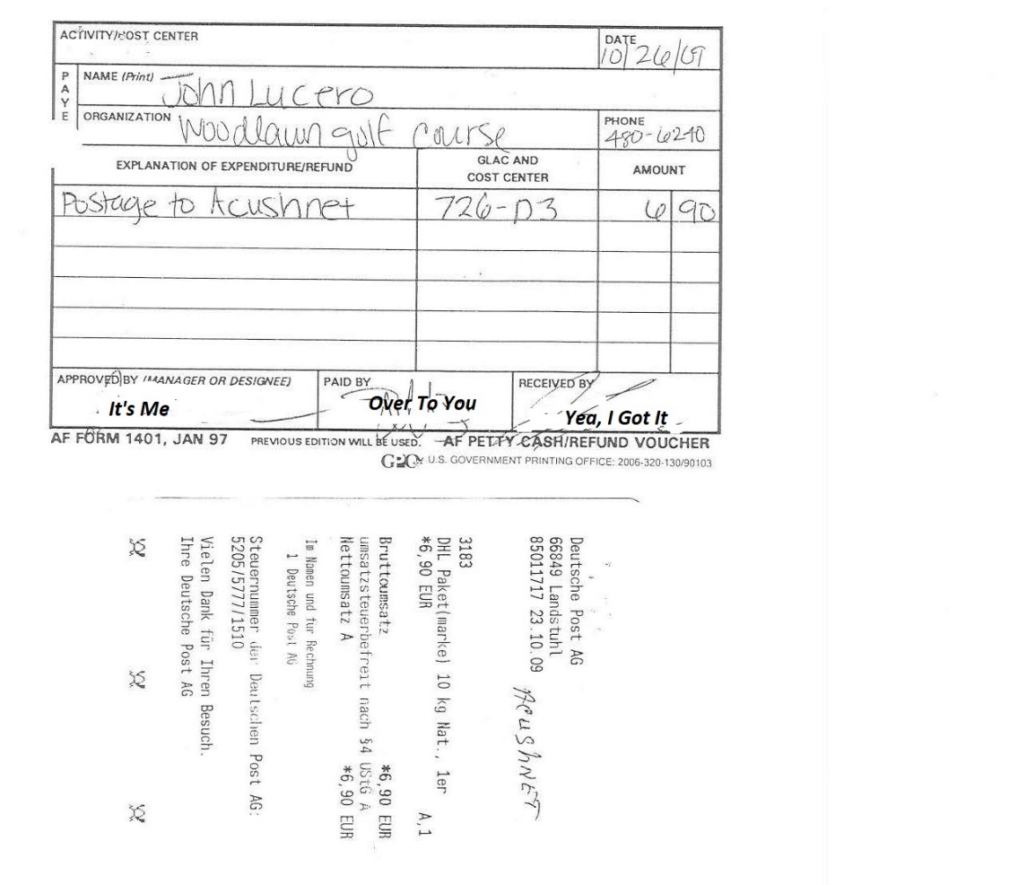
AFMAN 34-202 Instructions Training, continued…
NAF SURPRISE OR GENERAL CASHIER'S CASH COUNT
NAFI/COST CENTER 441XX/0000 | Your Facility |  |  | DATE XX-XX--XXXX |  | TIME 7:30 a.m.
DENOMINATION |  | U.S. OR FOREIGN |  | ACCOUNTABLE FORMS REVIEWED
U.S | FOREIGN | QUANTITY | AMOUNT | TYPE FORM | BEGIN NUMBER | END NUMBER
WRAPPED | WRAPPED
 | € 100 | 0 | € 0.00
 | € 50 | 1 | € 50.00
$20 | € 20 | 7 | € 140.00
$10 | € 10 | 4 | € 40.00
$5 | € 5 | 2 | € 10.00
$2 | € 2 | 0 | € 0.00
$1 | € 1 | 0 | € 0.00 | REMARKS | Disbursements:
 | Rolled | 0
 | € 2 | 0 | € 0.00
 | € 1 | 0 | € 0.00
$1 | .50 | 0 | € 0.00 | EURO CHANGE FUND
.50 | .20 | 0 | € 0.00 | EURO IMPREST FUND
.25 | .10 | 0 | € 0.00 | 2557's: €350 Funds Signed For
.10 | .05 | 0 | € 0.00 | 1401's €100.45 See Attached
.05 | .02 | 0 | € 0.00
.01 | .01 | 0 | € 0.00 | ACCOUNTABILITY
LOOSE $100 | LOOSE | 0 |  | OPEN REGISTER READING |  | 350.00 €
$50 | € 2 | 3 | € 6.00 | CLOSE REGISTER READING |  | 249.55 €
$20 | € 1 | 1 | € 1.00 | TOTAL REGISTER SALES |  | 0.00 €
$10 | .50 | 3 | € 1.50 | TOTAL NONREGISTER CASH RECEIPTS |  | 0.00 €
$5 | .20 | 3 | € 0.60 | TOTAL |  | 0.00 €
$2 | .10 | 4 | € 0.40 | LESS CHARGE SALES (2557)
$1 | .05 | 1 | € 0.05 | 1401'S PURCHASES TOTAL |  | 100.45 €
$1 | .02 | 0 | € 0.00 | UNDER/OVER RINGS
.50 | .01 | 0 | € 0.00 | TOTAL |  | 0.00 €
.01 | .10 | 0 | € 0.00
CHECKS | .05 |  | € 0.00
BANKS | .01 |  | € 0.00 | TOTAL |  | 100.45 €
1401s |  |  | € 100.45
2557 |  |  | € 0.00 | ADD CHANGE FUND |  | 249.55 €
TOTAL CASH |  |  | € 350.00 | TOTAL ACCOUNTABILITY |  | 350.00 €
 |  |  |  | OVER/SHORT |  | 0.00 €
I CERTIFY THE RECONCILIATION DATA AND THE TOTAL AMOUNT OF CASH, NEGOTIABLE INSTRUMENTS, AND CHARGE TICKETS WERE COUNTED BY ME; AND THE AMOUNT SHOWN IS CORRECT. |  |  |  | I CERTIFY ALL CASH, NEGOTIABLE INSTRUMENTS, AND CHARGE TICKETS FOR WHICH I AM RESPONSIBLE, AS LISTED ON THIS FORM, WERE RETURNED TO ME.
SIGNATURE AND PRINTED NAME OF VERIFIER |  |  |  | SIGNATURE AND PRINTED NAME OF CASHIER (Fund Holder)

Slide 20
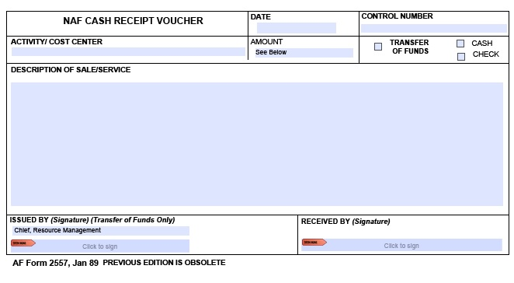
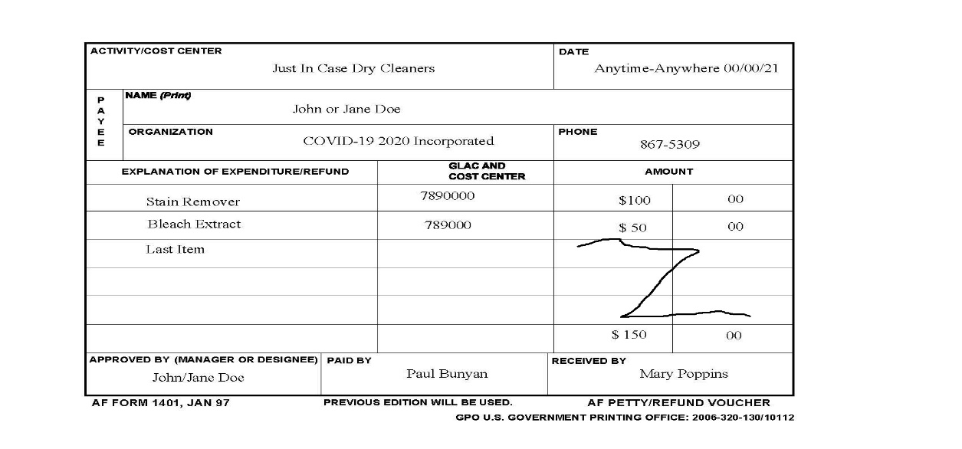
AFMAN 34-202 Example Forms Instructions Training continued…

Slide 21
AFMAN 34-202 Instructions Training continued…
Reviews expenditures and advances from petty cash to
ensure they were approved and are supported by AF Form 2557, or AF Form
1401, Air Force Petty Cash/Refund Voucher.
2. Ensure, when added to the cash on hand, the balance equals the amount of funds signed for.

Slide 22
AFMAN 34-202 Instructions Training
Determines accountability of cashiers' funds including payments for dues, fees, charges, and accounts receivable, by reconciling beginning cash, receipts, and accountable forms including closing out the cash register.
Consider any difference between cash on hand and the computed cash accountability a cash overage or shortage.
Report overages and shortages according to AMAN 34-202, Chapter 8, Losses And Collection Actions. Or Chapter 5, Controlling Change and Imprest Funds

Slide 23
AFMAN 34-202 Surprise Cash Count Instructions Training
Losses
    Up to and including $50
    Activity manager must have written approval from the RM to conduct an informal review
    Activity manager documents review results
    File documentation in the activity
    Greater than $50 up to and including $250, activity manager conducts a review
    Provides a brief written explanation to the RM

Slide 24
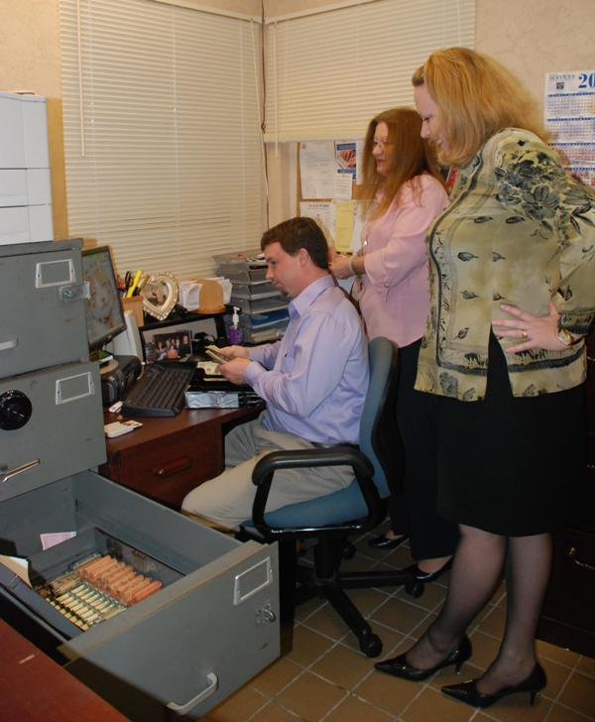
AFMAN 34-202 Surprise Cash Count Instructions Training
Losses continued…
    Greater than $250 to $1,000 and $250 and less which appear to involve negligence or willful misconduct
    The FSS Commander will appoint an individual to conduct an inquiry
    Perform a simulated surprise cash count

Slide 25
AFMAN 34-202 Surprise Cash Count Instructions Training
Training review should equip you to determine:
    Cash control procedures are current and comprehensive
    Only authorized personnel have access to cash
    Transfers of cash are supported by signed receipts
    Personal cash is not stored or commingled with activity’s cash
    Activity manager documents review results
    Provides a brief written explanation to the RM

Slide 26
CASH HANDLING TRAINING
Questions?
POC for this presentation:
Ms. Sandra Johnson – 480-6035
Ms. Elizabeth McCormick – 480-2453
Mr. Scott M. Wooley – 480-5979

